Slide 1
Lesson Objective
The aim of this lesson is for you to learn what the main events were in Hitler’s rise to power and to understand how each event helped him.
Write the title: Hitler’s Rise to Power
If you have your book then please work in your book, but if not work on lined paper or in a Word document on your computer.

Slide 2
TASK 1
Write the title: Hitler’s Rise to Power
Watch the clip about Hitler’s Rise to Power. You will have to scroll down the page to find the video.
While watching try to put the events on the right in order of which they happened.
Use the knowledge organiser attached if you need help with any key words that you don’t understand or see the next slide.
Events jumbled up.
Hitler wrote a book in prison called Mein Kampf where he outlined his ideas.
The Great Depression hit Germany and by 1932 and 6 million people were unemployed. These people started to turn to extreme political groups.
Hitler attempted to seize power in the Munich Putsch using violence.
President Hindenburg died and Hitler became the Fuhrer.
The Reichstag was set on fire and Hitler banned all other political parties.
Hitler killed people in his own party on the “Night of the Long Knives” to strengthen his control over the party.
President Hindenburg agreed to make Hitler Chancellor.
Clip: https://www.bbc.co.uk/bitesize/guides/z3bp82p/revision/1

Slide 4
Task 2: Hopefully you may already have a copy of the knowledge organiser, but if not see the attachment in the task on the VLE or the next slide.
For events 1-5 highlight in two colours the following:
Actions taken by the Hitler and Nazis
Positive outcomes for Hitler and the Nazis in their rise to power.
WE WILL DO EVENTS 6-9 NEXT WEEK
If you do not have a printed copy then make a simple list of how each event helped Hitler and the Nazi party to come to power.
e.g.
1) The Munich Putsch helped Hitler to come to power because it helped him to realise that if he was to come to power then he needed to use legal methods and get people to vote for him.
Knowledge Organiser

Slide 5
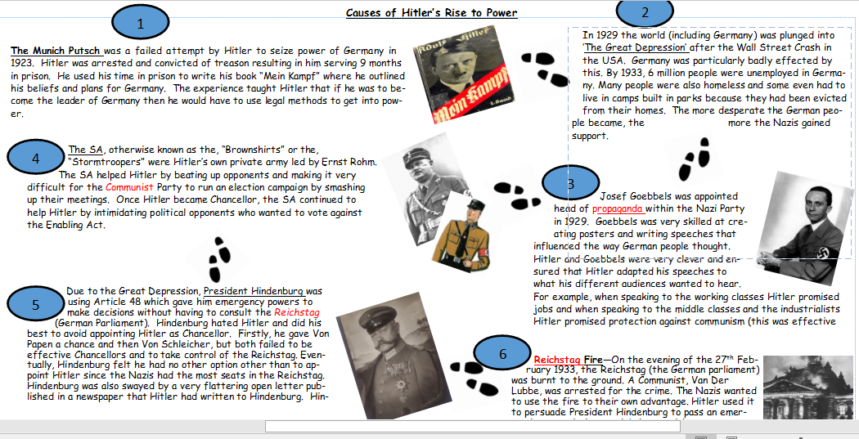

Slide 6
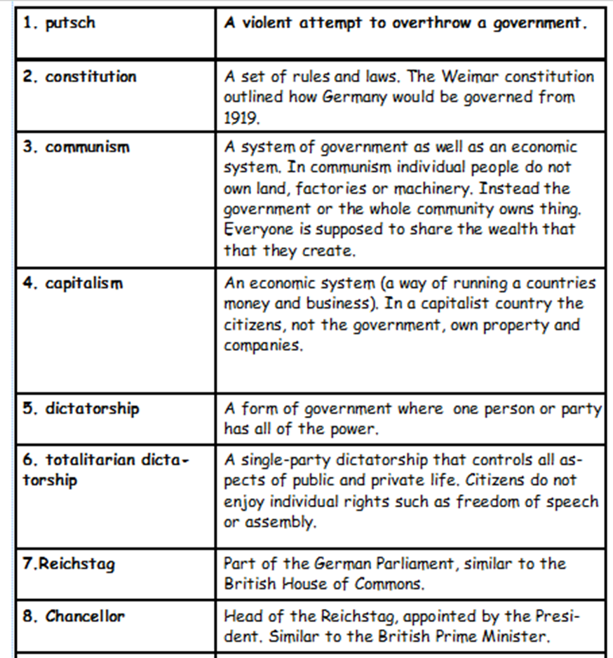
Task 3: Learn the meanings and the spellings of key words 1-8

Slide 7
Next lesson you will decide which of the 9 events you think is the most important in Hitler’s rise to power.
Optional Extra: You may want to finish watching the film we started in class. It is called “The Rise of Evil”
See links below:
Part 1 – https://www.youtube.com/watch?v=yMVy8_98I-o
Part 2 - https://www.youtube.com/watch?v=GrLK3iY4xb8

