Slide 1
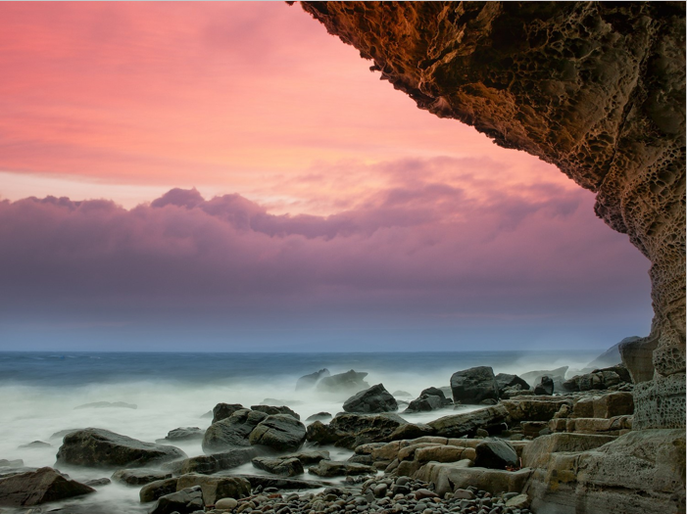
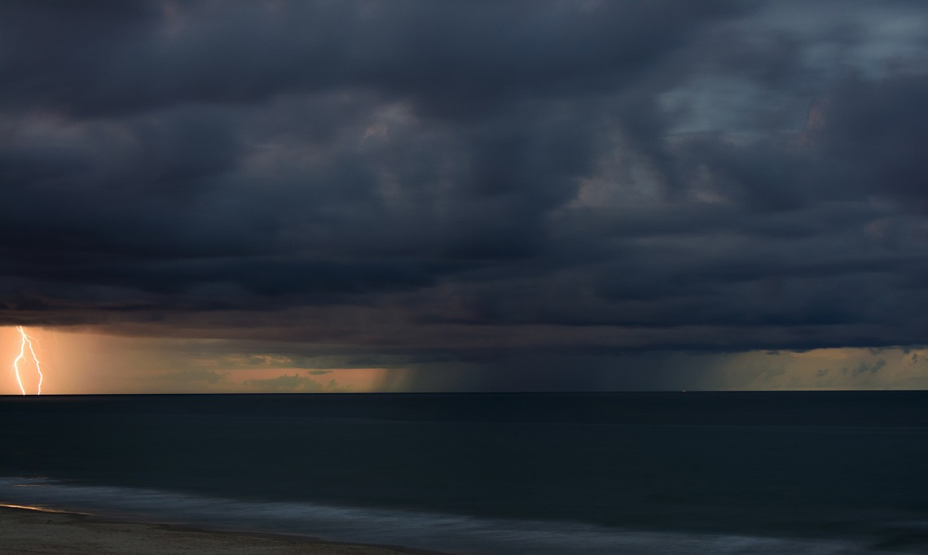
Homework
What were the impacts?
What were the rocks made of?
How long was the fetch?
What was the wind speed?
Why are these factors important?
Research a recent storm that has affected the coastline of Britain.

Slide 2
Homework
Examples you could research:
Storm Brian
Storm hector

Slide 3
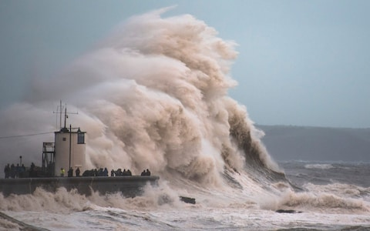
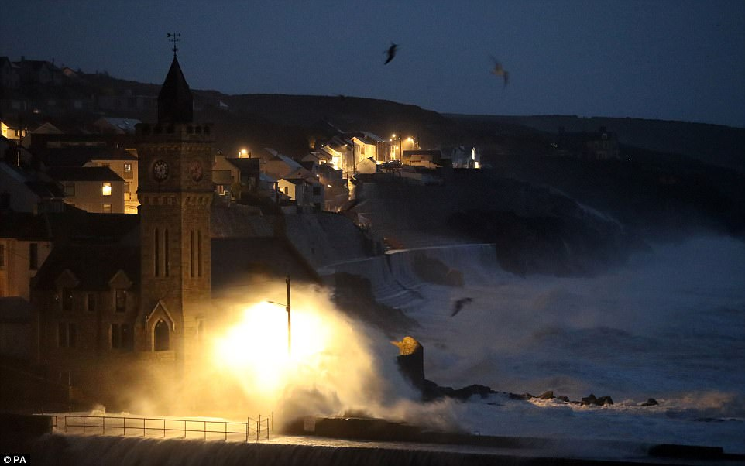
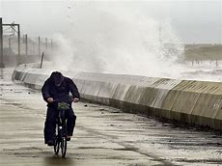
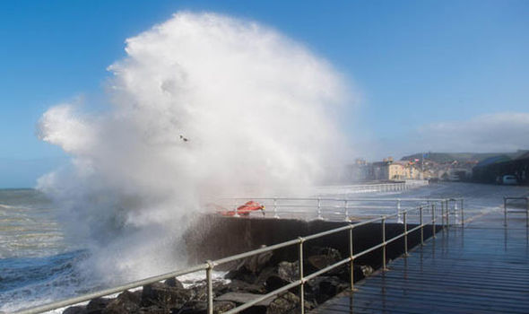
Homework
Photos you can use:

